Slide 1



Stock Price Predictor
Presenter: Sanatan khemariya

Slide 2

Section 1
Introduction to Stock Price Prediction

Slide 3


Objective of the Analysis
Comprehensive Stock Analysis
This analysis aims to develop a predictive model that integrates historical data, feature engineering, and comparative modeling techniques to enhance stock price forecasting accuracy, ultimately guiding informed investment decisions.

Slide 4







Scope of the Study
Focused Data Analysis
The study emphasizes analyzing historical stock data across diverse sectors to uncover patterns and enhance predictive accuracy in stock price movements.
Robust Data Collection
This dataset includes daily stock prices and trading volumes for 10 major companies. The data is stored in a structured format to support further analysis and modeling.
Advanced Analytical Techniques
Employing machine learning models and quantitative methods, the study aims to refine forecasting capabilities and evaluate model performance through established metrics.

Slide 5
Section 2
Data Preparation and Exploratory Data Analysis

Slide 6


Data Preparation Overview
01
02
Importance of Data Quality
Role of Feature Engineering
Effective feature engineering transforms raw data into meaningful inputs for models, allowing for improved predictive capabilities by capturing essential patterns and relationships within the stock market data.
Ensuring high-quality data is essential for accurate stock price predictions; this includes verifying data sources, consistency, and timeliness to enhance model reliability and performance.

Slide 7

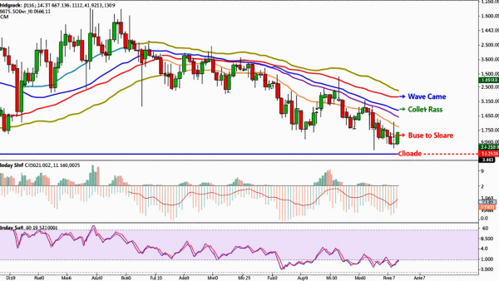

Historical Stock Data Insights
Trend Identification Techniques
Volatility Assessment Methods
Correlation and Diversification
Utilizing moving averages and regression analysis, analysts can effectively identify and quantify long-term price trends, providing a basis for future stock price predictions and investment strategies.
Historical stock data allows for the calculation of volatility metrics, such as standard deviation and beta, which help investors gauge risk and adjust their portfolios accordingly during market fluctuations.
By analyzing historical correlations between stocks, investors can strategically diversify their portfolios, minimizing risk while capitalizing on potential market movements influenced by shared economic factors.

Slide 8


Exploratory Data Analysis Findings
01
02
03
Descriptive Statistics Insights
Trend Visualization Analysis
Correlation and Anomalies
Key metrics reveal an upward trend in mean stock prices, indicating growth, while high standard deviation suggests significant volatility, impacting risk assessments.
Line charts illustrate stock price fluctuations over time, highlighting trends linked to market events and periods of volatility that require further investigation.
Correlation analysis uncovers relationships between stocks and macroeconomic indicators, while anomaly detection identifies outliers that may influence predictive modeling strategies.

Slide 9


Key Trends and Correlations
.
.
01
02
Identifying Market Cycles
Economic Indicator Relationships
Recognizing cyclical patterns in stock prices, such as bull and bear markets, enhances predictive models by allowing adjustments based on prevailing market conditions and investor sentiment.
Analyzing correlations between stock prices and economic indicators like interest rates and inflation provides critical insights, enabling traders to anticipate market movements and refine their investment strategies.

Slide 10
Section 3
Feature Engineering and Model Development

Slide 11

Importance of Feature Engineering
Optimizing Predictive Accuracy
Feature engineering is crucial for enhancing predictive accuracy in stock price models by transforming raw data into relevant features, enabling models to capture complex market dynamics and improve decision-making in financial contexts.

Slide 12

Models Utilized for Prediction
Diverse Model Selection
A combination of time series and machine learning, enhances the robustness of stock price predictions by capturing various market dynamics.
Model Performance Evaluation
Each model's effectiveness is assessed using metrics like RMSE and R-squared, ensuring that only the most accurate models inform trading strategies.
Adaptability to Market Changes
Selected models must demonstrate the ability to adapt to evolving market conditions, ensuring continued relevance and accuracy in stock price forecasting.

Slide 13




Best Performing Model Overview
02
01
03
Evaluation Metrics Significance
Feature Importance Analysis
Model Architecture Insights
The use of RMSE, MAE, and R-squared provides a comprehensive assessment of model performance, ensuring reliability in stock price forecasting.
Key features like moving averages and trading volumes significantly enhance the model's predictive capabilities, capturing essential market trends and dynamics.
ARIMA and SARIMA leverage statistical time-series forecasting by capturing trends, seasonality, and temporal dependencies, making them robust for modeling stock price fluctuations and market patterns.

Slide 14
Section 4
Model Evaluation and Comparison

Slide 15
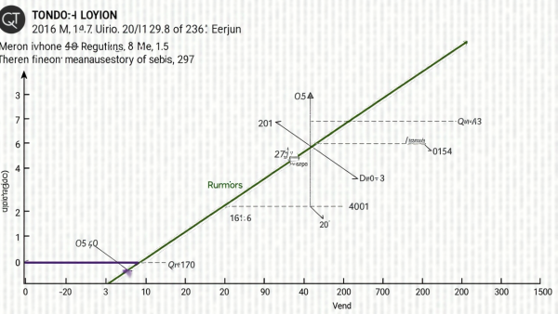


Evaluation Metrics Explained
Understanding MAE's Role
Contextualizing MAPE's Value
Significance of RMSE
Mean Absolute Error (MAE) provides a straightforward measure of average prediction error, making it essential for assessing model performance in stock price forecasting with clear interpretability.
Mean Absolute Percentage Error (MAPE) normalizes prediction errors as percentages, facilitating comparisons across different stocks and datasets, thus enhancing stakeholder understanding of model accuracy.
Root Mean Squared Error (RMSE) emphasizes larger errors, offering critical insights into model performance, particularly in financial contexts where significant mispredictions can lead to substantial losses.

Slide 16


RMSE Comparisons of Models
Strategic Model Selection
02
Model Performance Insights
01
Choosing the right model based on RMSE not only enhances prediction accuracy but also informs investment strategies, ultimately impacting profitability and risk management in trading activities.
The RMSE values reveal significant performance disparities among models, with LightGBM achieving the lowest RMSE, indicating its superior predictive accuracy in stock price forecasting scenarios.

Slide 17

Insights from Model Performance
Feature Engineering Impact
The analysis highlights that incorporating diverse features significantly enhances model accuracy, underscoring the importance of thoughtful feature selection.
Generalization Capability
Market Adaptability
ARIMA and SARIMA's ability to capture underlying patterns and seasonality in stock price data enables them to adapt dynamically, making them reliable for forecasting market trends with minimal bias.
LightGBM's consistent performance across varying market conditions demonstrates its robustness, essential for investors navigating volatile environments.

Slide 18
Section 5
Business Implications and Recommendations

Slide 19

Utilizing LightGBM for Forecasting
Enhanced Predictive Performance
Leveraging ARIMA & SARIMA allows for improved accuracy in stock price forecasting, enabling investors to make data-driven decisions that optimize trading strategies and enhance overall portfolio performance.

Slide 20
Strategic Buy/Sell Decisions
02
01
03
Market Indicator Integration
Data-Driven Decision Making
Risk Management Strategies
Continuously assess economic indicators and sector news to refine buy/sell strategies, enhancing responsiveness to market dynamics.
Align buy/sell decisions with individual risk tolerance, balancing aggressive investments with conservative choices to optimize portfolio performance.
Leverage predictive analytics to identify optimal buy/sell opportunities, ensuring decisions are based on reliable forecasts and market trends.

Slide 21

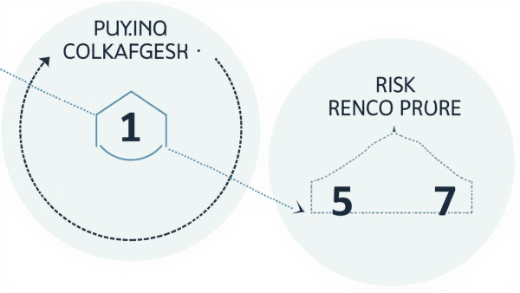


Risk Management Strategies
Comprehensive Risk Assessment
Dynamic Risk Adjustment
Investor Education and Training
Implement flexible risk management protocols that adapt to changing market conditions, allowing for timely adjustments in investment strategies to mitigate losses and capitalize on emerging opportunities.
Conduct thorough evaluations of potential risks by analyzing market trends, economic indicators, and historical data to inform strategic investment decisions and enhance portfolio resilience.
Promote continuous learning for investors regarding risk management techniques, ensuring they are equipped with the knowledge to make informed decisions and effectively navigate market volatility.

Slide 22
Section 6
Final Deliverables and Next Steps

Slide 23
Overview of Deliverables
.
.
01
02
Presentation of Key Insights
Comprehensive Technical Documentation
A detailed technical report accompanies the presentation, providing in-depth explanations of methodologies, model evaluations, and strategic recommendations to enhance understanding and application of the analysis.
The deliverables include a structured PowerPoint presentation that effectively communicates critical findings, ensuring stakeholders grasp essential insights for informed decision-making in stock trading.

Slide 24



Future Directions for Research and Analysis
Alternative Data Integration
Behavioral Finance Insights
Future research should prioritize the incorporation of diverse data sources, such as social media sentiment and economic indicators, to enhance predictive accuracy and model robustness in stock price forecasting.
Real-Time Predictive Models
Incorporating behavioral finance principles into predictive models can deepen understanding of market anomalies and investor biases, leading to more accurate stock price predictions and informed investment strategies.
Developing models that can provide real-time predictions will enable investors to make timely decisions, adapting strategies dynamically to market changes and improving overall trading effectiveness.

Slide 25
Thank You
Contact:
sanatankhemariya@gmail.com

